Slide 1
Analysing Stock Prices
with Python

Slide 2
Capstone Project: Analysing Stock performance
Problem Definition: To analyze stock performance over a 5 year period. Also to compare similar stocks.
Dataset: YFinance
Stocks: Apple & Microsoft
Metrics: Derive information on Stock movement, Ratios, Returns, Volatility
Visualization: Display the information using Graphs, Histograms, Bollinger Bands, HeatMap, Scatter Plot, Candles chart

Slide 3
Import stocks price data from Yahoo Finance - Analyze the data & compare performance
Download data from yahoo finance using stocknames example ['MSFT', 'AAPL']
Plot normalised graphs, ie, starting at 1 for all
Daily returns ratio = df.pct_change()
Bollinger Bands
Metrics: Daily Returns Ratio, Annualized Returns, Annualized Volatility,
Metrics: Correlation using HeatMap, Scatter Plot, Co-efficient
Cumulative Returns
Candles chart

Slide 4
Download Data from YFinance
stocknames = ['AAPL', 'MSFT'] #ticker
startdate = '2019-01-01' #Start Date
enddate = '2023-12-31' #End Date
interval = '1d' #Interval
for stock in stocknames:
df = yf.download(stock, interval=interval, period='max')
df.to_csv('stocks_data\\{}.csv'.format(stock))

Slide 5
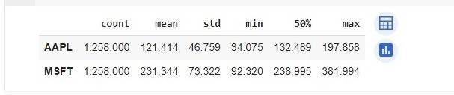
Global Statistics
df_desc = df.describe().T
df_desc[['count', 'mean', 'std', 'min', '50%', 'max']]

Slide 6
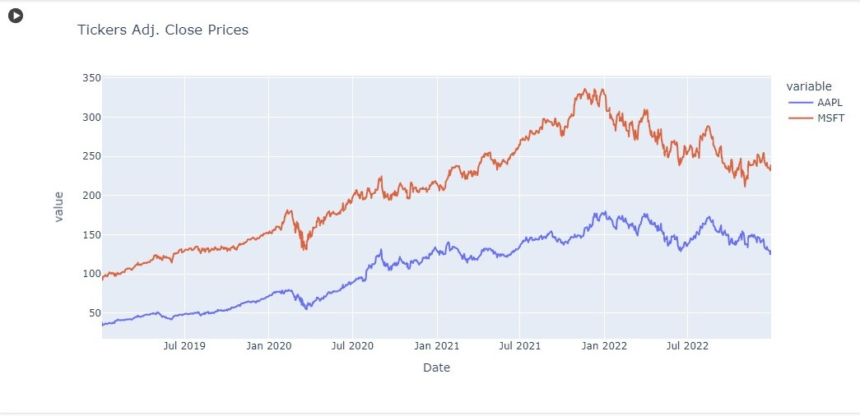
A Quick look at the prices - Adj. Closing Price
from plotly import express as px
px.line(data_frame=df, title='Tickers Adj. Close Prices', width=1000, height=500)

Slide 7
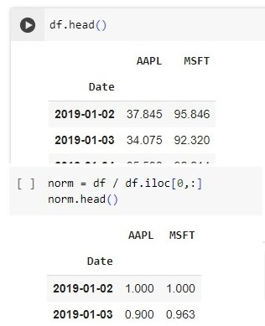
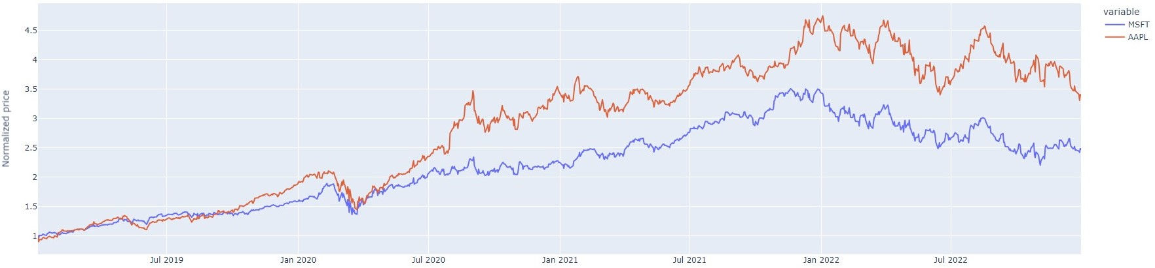
Stock Movement by Adj. Closing Price(Daily Cumm. Return)
We need to observe the relative stock movement, i.e. how much the stock went up or down compared to the other stocks. Therefore we need to Normalize the stock prices to start with $1.
To do this we will divide the prices of each column by Day-One-Price. - Norm=df/df.iloc[0,:]

Slide 8
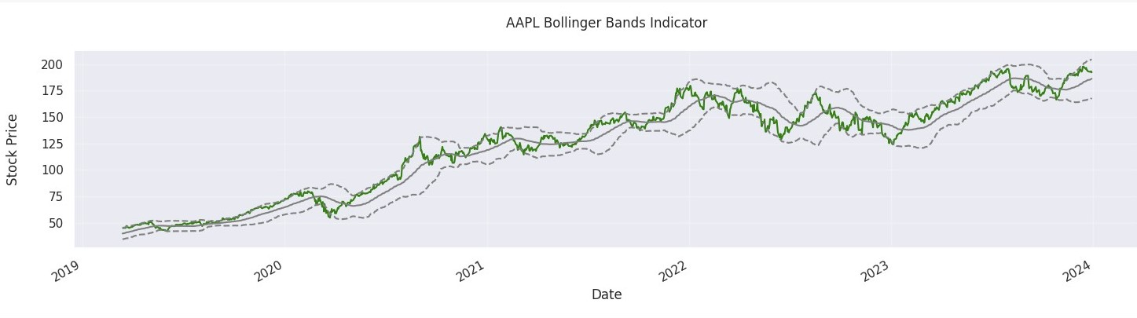
Bollinger’s Band
Bollinger Bands® is a technical analysis tool to generate oversold or overbought signals and was developed by John Bollinger.
Three lines compose Bollinger Bands: A simple moving average, or the middle band, and an upper and lower band.
The upper and lower bands are typically 2 standard deviations +/- from a 20-day simple moving average and can be modified.
When the price continually touches the upper Bollinger Band, it can indicate an overbought signal.
If the price continually touches the lower band it can indicate an oversold signal.

Slide 9
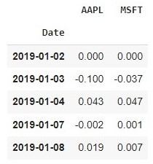

Metrics - Daily Returns Ratio: how much did the price go up or down on a particular day
DailyReturns(t)=(price[t]/price[t−1])−1
daily_returns = (df / df.shift(1)) -1
#Daily Returns Ratio global statistics
daily_returns.describe().T

Slide 10
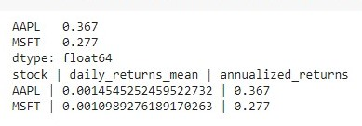
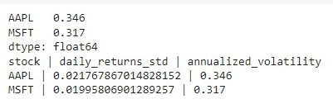
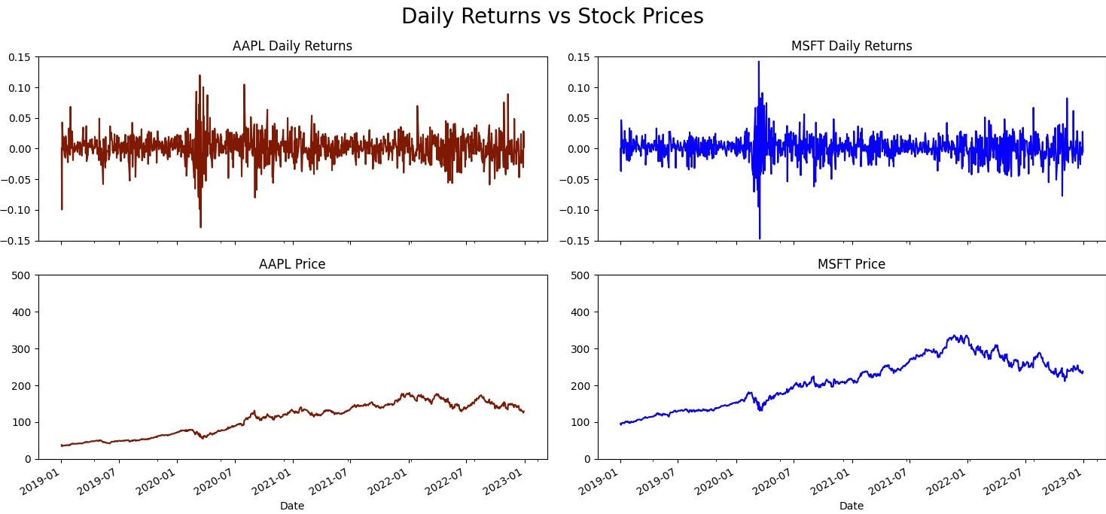
Metrics - Annualized Returns, Annualized Volatility
Annualized Return - A measure of how much an investment has increased on average each year during a specific period
annualized_returns = df.pct_change().mean().apply(lambda x: x*252)
Annualized Volatility - Calculated by multiplying the standard deviation of a set of monthly returns by the square root of 12
annualized_volatility = df.pct_change().std().apply(lambda x: x*np.sqrt(252))

Slide 11
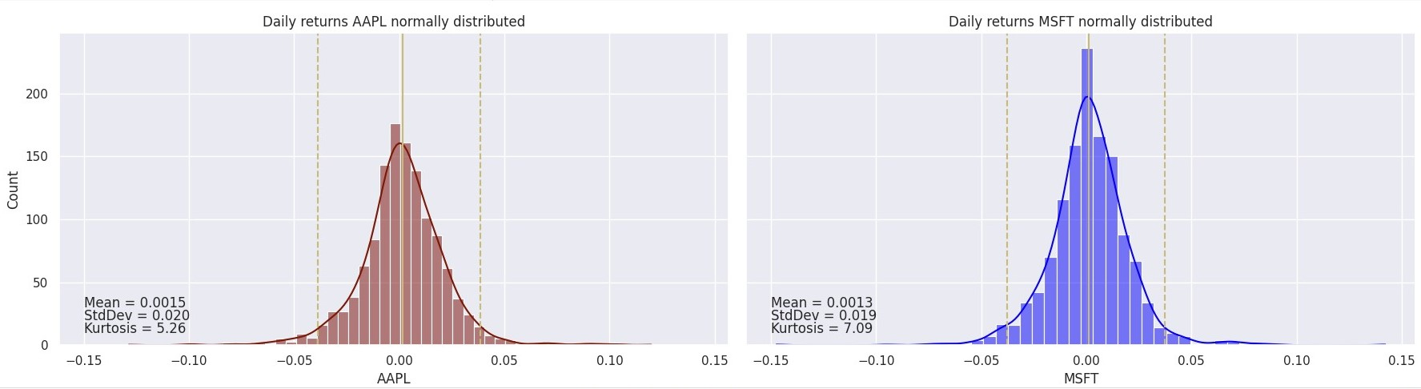
Metrics - Daily Return Statistics
fig, ax = plt.subplots(1,2, figsize=(18,5), sharex=True, sharey=True)
sns.histplot(daily_returns.MSFT, bins=50, color='navy', ax=ax[0], kde=True)
sns.histplot(daily_returns.AAPL, bins=50, color='darkred', ax=ax[0], kde=True, alpha=0.5)
ax[0].set_xlabel('MSFT vs. AAPL')
plt.tight_layout()
1 - The Mean - use this to calculate Annualized Returns
2 - Standard Deviation - use this to calculate Annualized Volatility
3 - Kurtosis: tell us about the tails of the normal distribution. the measure of Kurtosis tells us how much different our histogram is from that traditional normal distribution.

Slide 12
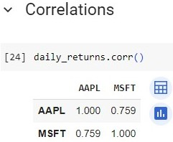
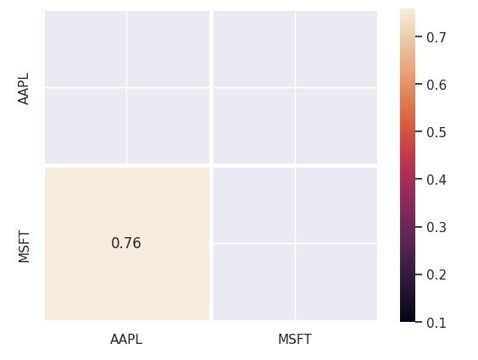
Metrics - Correlations
sns.heatmap(daily_returns.corr(), annot=True, vmin=0.1, mask=mask, linewidths=2.5)

Slide 13
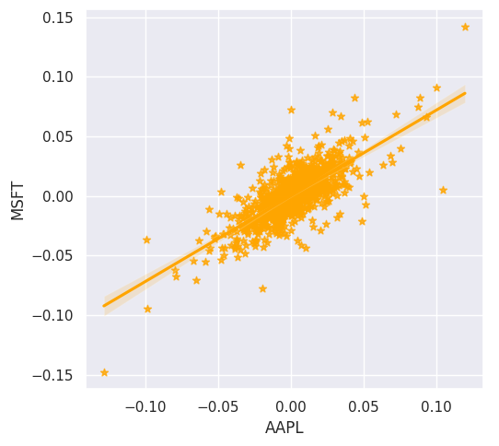
Metrics - Correlations - Scatter Plot
fig, ax = plt.subplots(1,2, figsize=(10,5), sharex=True, sharey=True)
sns.regplot(data=daily_returns, x=daily_returns.AAPL, y=daily_returns.MSFT ,scatter=True, marker='*', ax=ax[0], color='orange')
plt.tight_layout()

Slide 14
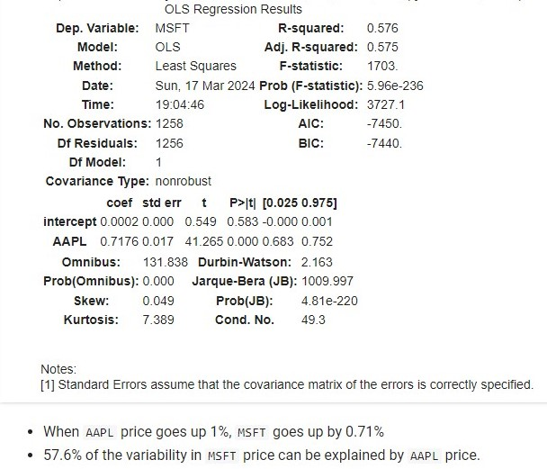
Metrics - Correlation Coefficient, Pvalue, and Beta using Stats model (Simple Linear Regression)
!pip install statsmodels
import statsmodels.api as sm
ml = daily_returns.copy()
ml['intercept'] = 1
lm = sm.OLS(ml.MSFT, ml[['intercept', 'AAPL']])
res = lm.fit()
res.summary()

Slide 15
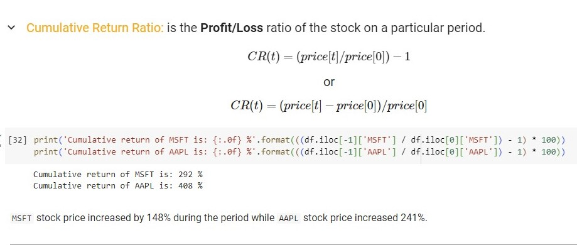
Metrics - Cumulative Returns

Slide 16
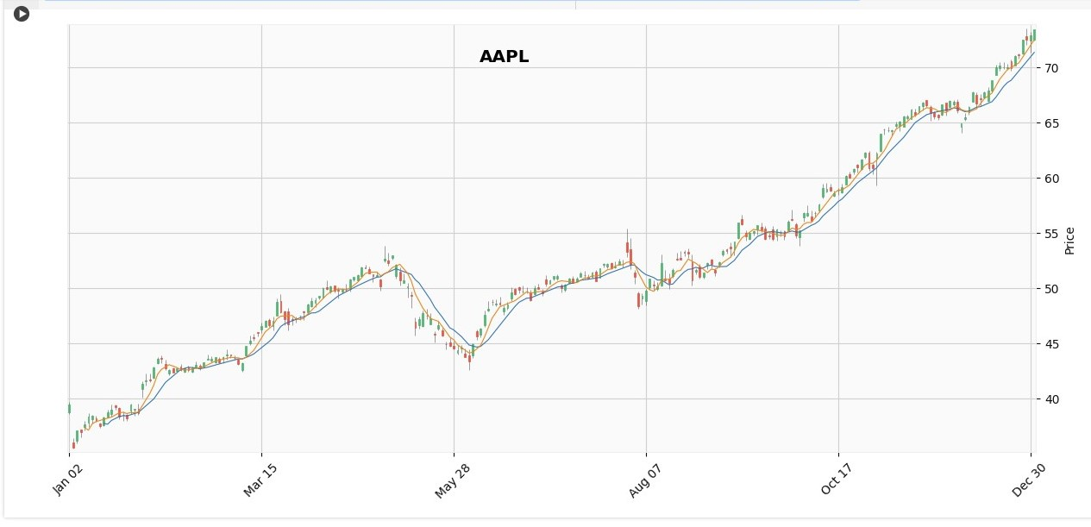
Candles Chart
Candlestick charts show that emotion by visually representing the size of price moves with different colors.
- Traders use candlestick charts to determine possible price movement based on past patterns.
- Useful when trading as they show four price points (open, close, high, and low) throughout the period the trader specifies.
df_aapl = pd.read_csv('AAPL.csv', index_col=0, parse_dates=True)
mask = (df_aapl.index >= '2019-01-01') & (df_aapl.index <= '2019-12-31')
df_aapl = df_aapl.loc[mask]
mpf.plot(df_aapl, type='candle', volume=False, mav=(10,5), title='AAPL', tight_layout=True, figratio=(18,8), style='yahoo')

Slide 17
Thank You

